Slide 1
30 YEARS OF VIDEO GAMES
1983 - 2012 RETROSPECTIVE INDUSTRY ANALYSIS
by Agata Świniarska

Slide 2






QUICK HISTORY OF INDUSTRY MILESTONES
1958 - First video game
“Tennis for Two”
1983 - GameLine
First online platform for purchasing games.
1978 - First game to sell
1 million copies
“Space Invaders”
1997 - Ultima Online
First massively successful commercial online rpg
2023 - Helldivers II Latest hit with peak ~459,000 players across platforms
1981 - Birth of the gaming icon - Mario

Slide 3
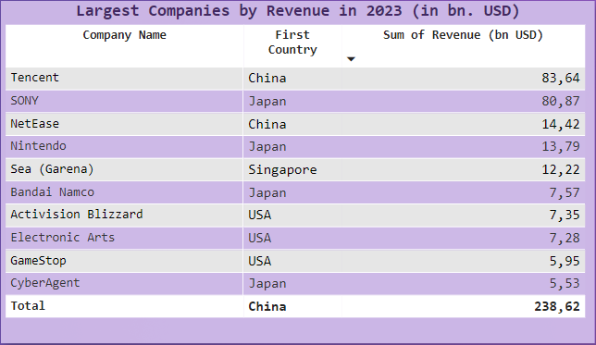
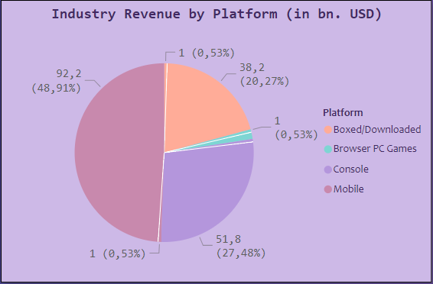
CURRENT SCALE OF THE INDUSTRY
Potential analysis setbacks:
Years 2013 - 2024 include outliers like the pandemic and economic downturns;
Individual game statistics are released under the discretion of the publishers, which makes detailed analysis challenging.
Ideas and solutions:
Utilize game compatibility of different platforms;
Observe acquisitions and buyouts by companies who are more willing to share data.

Slide 4
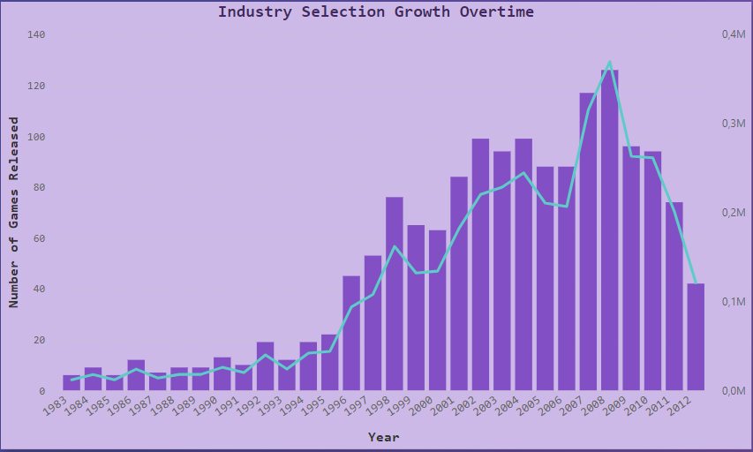
HOW FAST DID THE INDUSTRY GROW IN YEARS 1983 - 2012?
Dataset introduction: Andy Bramwell for Kaggle - Discovering Hidden Trends in Global Video Games.
~2000 values and 14 fields. Dataset cleaned with Tableau Data Prep, visualized in PowerBi and supplemented by additional references. 3 decade business observation of video game industry - global sales, reviews, global ranking, countries, publishers.
Potential setbacks for analysis:
Data might be missing key historical context;
Ideas and solutions:
Identifying key events that caused skewed data could help with re-creating positive trends.

Slide 5
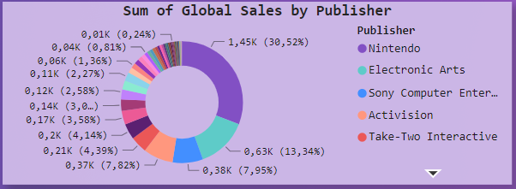
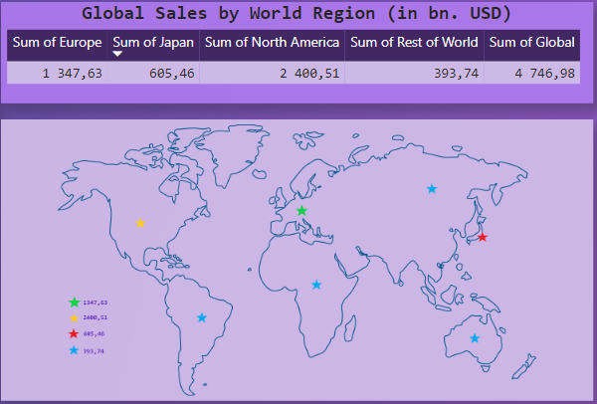
WORLDWIDE PUBLISHING TRENDS
Potential analysis setbacks:
Companies tend to grow with successful titles, pushing smaller studios out of data visibility;
Data has a time bias - Nintendo, Sony, EA have been on the market since 1979, 1994 and 1983 respectively;
Exclusion of crucial geographical data.
Ideas and solutions:
Data could benefit from separating “indie game market” from “A+ titles”;
Expand geographical data to include different markets
(Famously difficult Australian market, South America, Africa, Asia in detail).

Slide 6
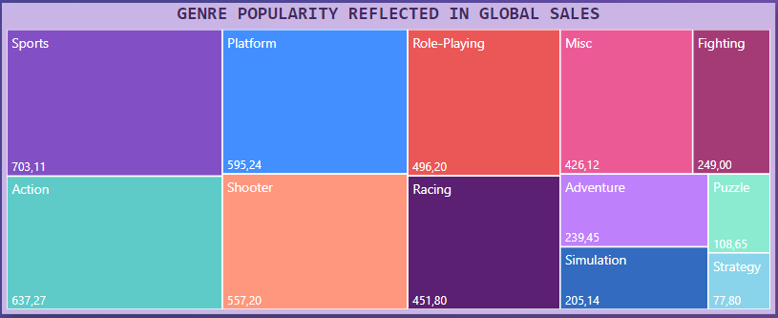
DOES TITLE POPULARITY REFLECT IN SALES?
Examples of disparity between popularity and profitability:
Question: Do well reviewed games also guarantee a good sale?
THAT DEPENDS!
Quality of port to other platforms;
Country of distribution;
Endurance on the market;
Target audience;
Current trends and
preferred genres;
Smooth release;
Production costs;
Price.
Aliens:Colonial Marines (2013)
Metacritic user score: 3.9
Metascore: 48/100
Copies Sold: 131 million Europe, US
Alan Wake 2 (2023)
Metacritic user score: 8.7
Metascore: 89
Copies Sold: ~1.3 million globally

Slide 7
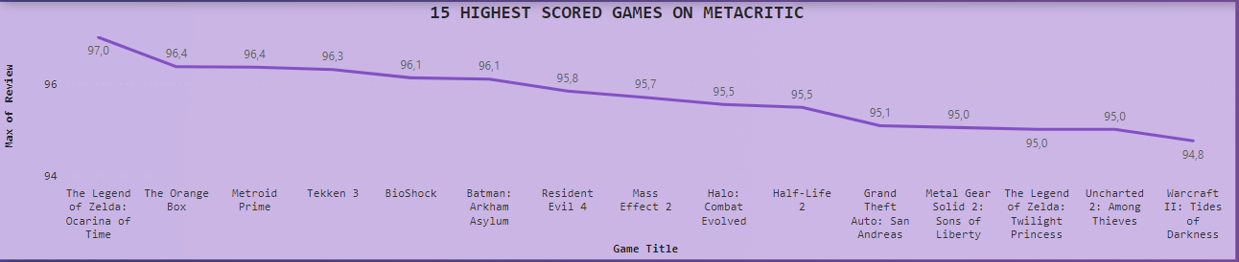
WHICH GAME COULD BE DESCRIBED AS “A PERFECT RETRO GAME”?
Potential analysis setback:
Metacritic is often referenced, but it’s not the only media scoring and evaluating titles;
Dataset exclusively takes into account the average of Metascore, skipping over user variable.
Ideas and solutions:
Inclusion of data indicating metacritic user score for a better idea of title popularity;
Number of reviews over time could better illustrate the correlation between average score and presence on the market.

Slide 8
IN CONCLUSION
🎮 Video game market has grown exponentially in the 30 years following its inception. Invention of new genres, business models and new approaches towards the target audience allowed the market to blossom into the phenomenon we know today.
🎮 There is a potential for another analysis of the market referring to years 2013-2024.
As the industry continues to grow in creativity and volatility, this analysis could better explain the jump in global sales in revenues between decades.
🎮 Dataset presented focuses on global sales and trends in history of the video game industry, but lacks important historical and situational context that could help make better informed business decisions for developers and publishers.
🎮 Dataset needs to be expanded in order to differentiate between countries, independent and commercial market and timelines.
🎮 There are a lot of moving factors that contribute to creating “a good game”, or a sales hit.

Slide 9
Thank you for your attention.
CREDITS & REFERENCES:
Main credit:
Andy Bramwell, Dataset: Discovering Hidden Trends in Global Video Games
Graphics:
https://reservoircreative.studio/portfolio/helldivers2/
https://www.muycomputer.com/2018/10/22/tennis-for-two-primer-videojuego-60-anos/
https://www.neoteo.com/gameline-el-steam-para-atari-2600-de-los-anos-80/
Additional references:
https://www.statista.com/forecasts/368026/people-who-shopped-for-toys-at-gamestop-in-the-last-12-months-usa
https://helplama.com/game-industry-usage-revenue-statistics/

